Slide 1
Café Management System
Introduction to database

Slide 2
Operations Used
Café System
Employee
Customer
Menu
Meal
Drink
Dessert
Order Information
Sales Profit

Slide 3

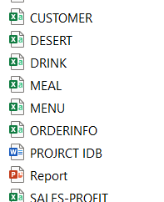
Operation

Slide 4
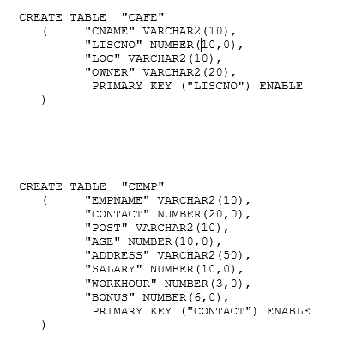
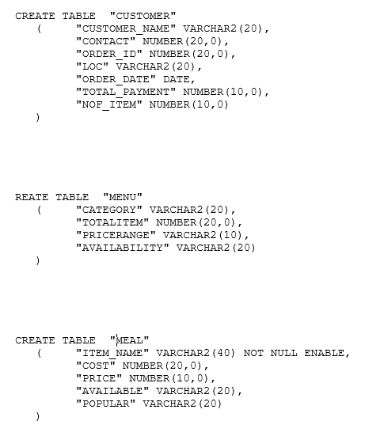
SQL Code

Slide 5
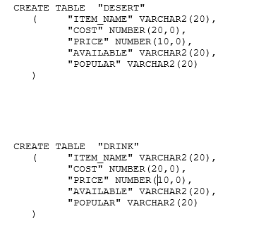
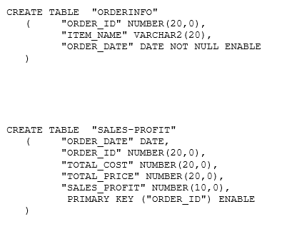
SQL Code Continue

Slide 6
THANK YOU
.

